Slide 1
Various Distributions

Slide 2
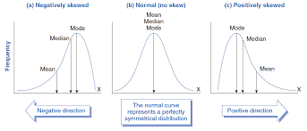
Skewed Distribution

Slide 3
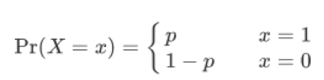
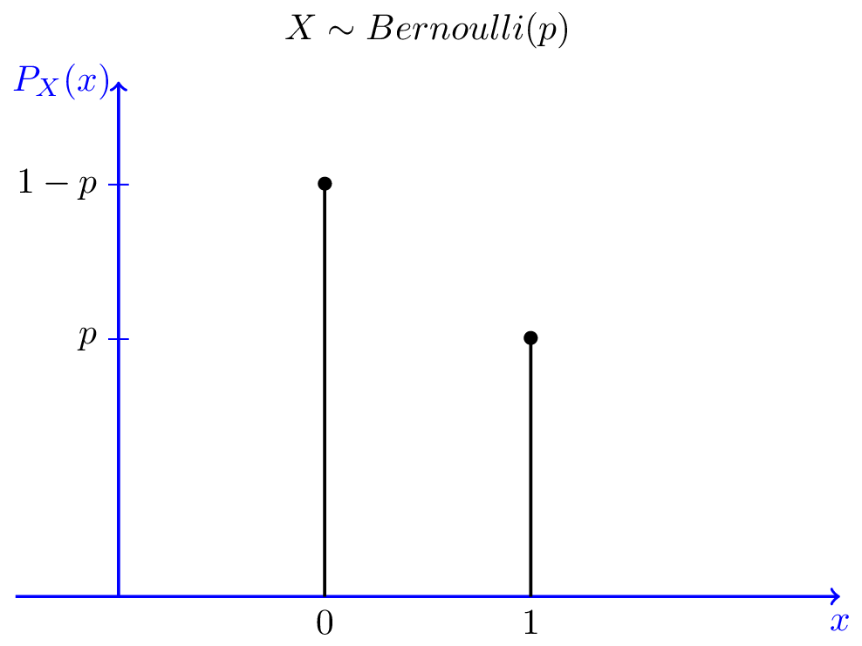
Bernoulli’s Distribution

Slide 4
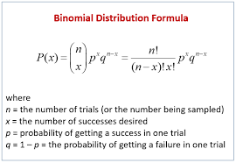

Slide 5
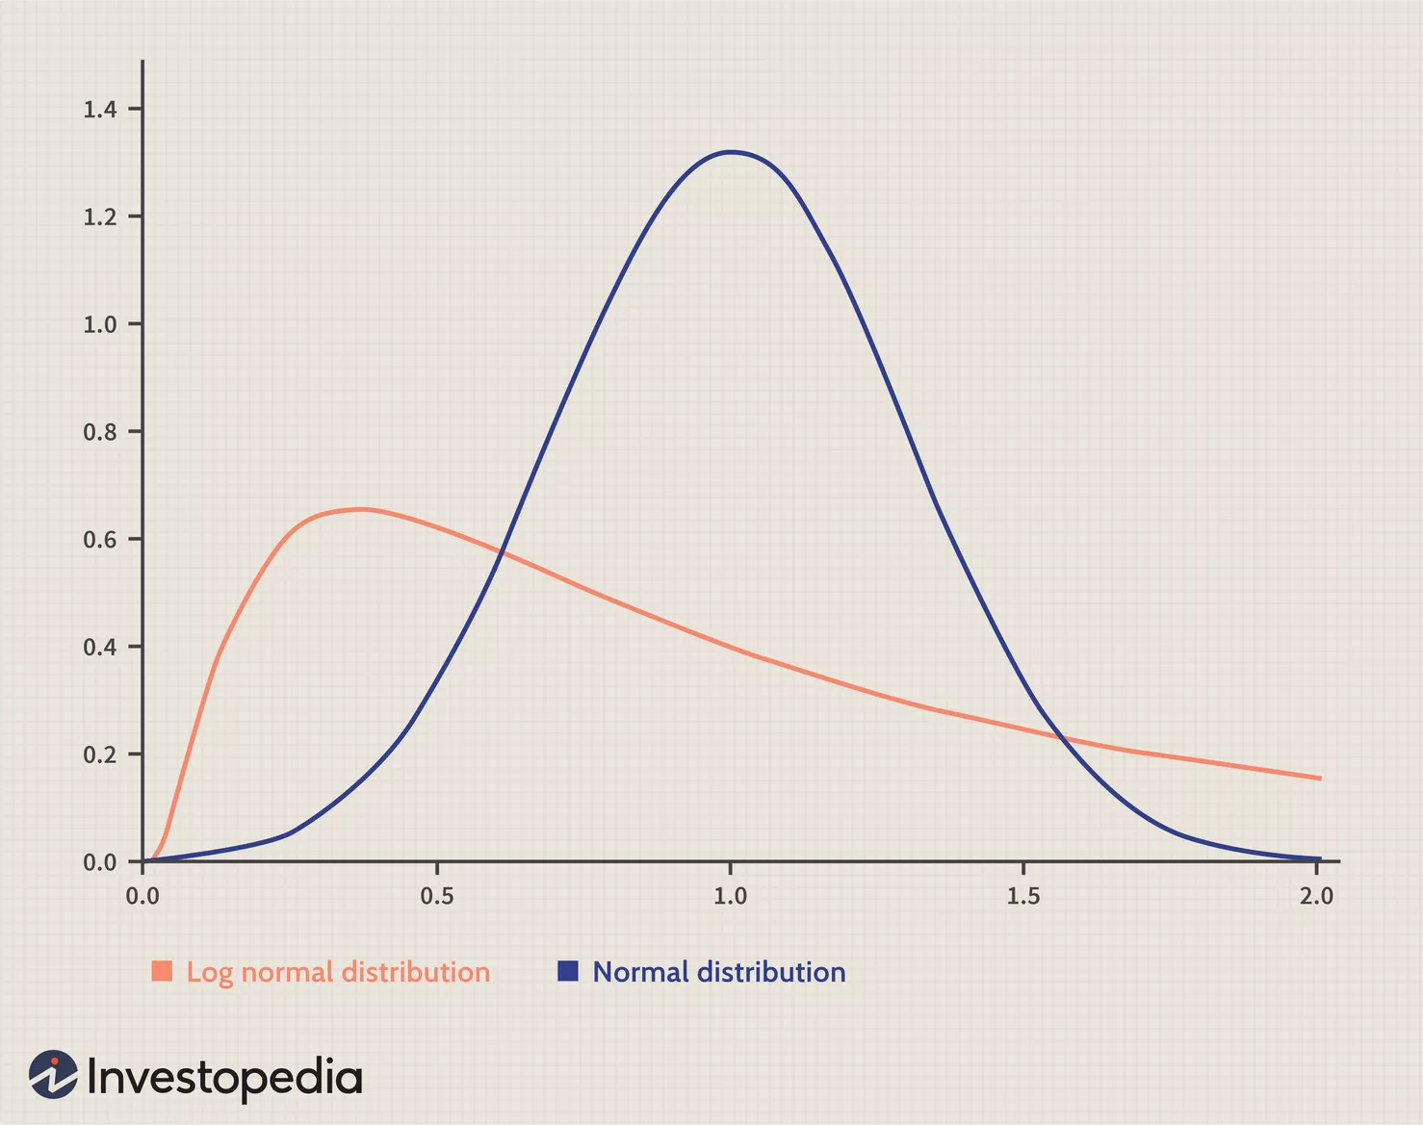
Log normal distribution

Slide 6
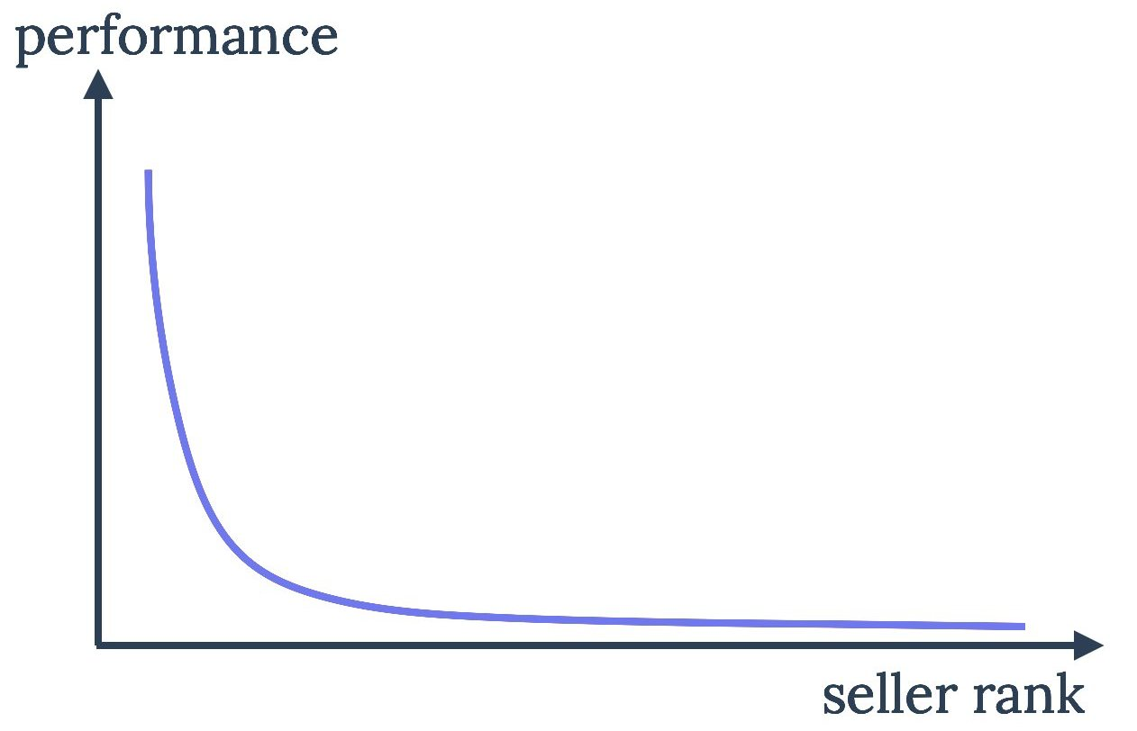
Power law distribution
It follows 80-20 rule

Slide 7
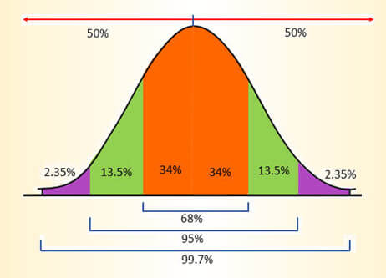
Empirical Rule

Slide 8

Chebyshev’s theorem
It says that the min. proportion of data that can be found within k standard deviations from the mean is :

Slide 9
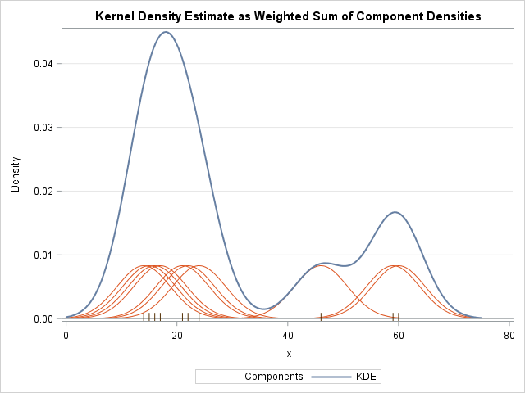
Kernel density estimation

